Slide 1
ONLINE VEHICLE PARKING RESERVATION SYSTEM
M.SHRAVYA - 247R1A0530
N.LOKESH - 247R1A0537
N.KAUSHIK - 247R1A0539
UNDER THE GUIDANCE OF
Mr.SVSV PRASAD SANABOINA
ASSISTANT PROFESSOR

Slide 2
TABLE OF CONTENTS
Introduction
Abstract
Problem statement
Existing system
Proposed system
Advantages
Disadvantages
Software and hardware requirements
System architecture
Novelty of the project
Modules
UML diagrams(use case diagrams,class diagrams,sequence diagrams)
source code
Result
Conclusion and Future Enhancement
References

Slide 3
Abstract
Parking problems are increasing in cities due to more vehicles
Traditional parking is slow and inefficient
This system allows users to:
Check parking availability
Book slots online
Make payments easily
Helps reduce time, traffic, and pollution
Provides real-time updates and smart management
Rapid increase in vehicles causes parking issues
Proposed system provides:
Real-time slot availability
Online booking and payment
Reduces traffic congestion
Saves time and fuel
Improves user convenience

Slide 4
Introduction
Urban areas face serious parking problems
Drivers waste time searching for parking
Leads to pollution and frustration
Need for smart parking solution
System allows:
Easy booking
Navigation support
Quick access

Slide 5
Problem Statement
Rapid increase in vehicles creates parking shortage
Drivers spend a lot of time searching for parking
Traditional systems are:
Manual
Time-consuming
Inefficient
No real-time information about available slots
Causes:
Traffic congestion
Fuel wastage
Air pollution
Lack of online booking and automation
Need for a smart and efficient parking solution

Slide 6
Existing System
Parking is mostly managed manually
Drivers search for parking spaces physically
No proper system to track available slots
Some places use basic ticket systems
No real-time updates on slot availability
No mobile or web-based booking system
Limited use of modern technologies
No proper monitoring or data analysis
Difficult for users during peak hours

Slide 7
Proposed System
User-Friendly Platform Web and mobile apps allowing easy search and reservation of parking spaces.
Real-Time Availability Dynamic updates to show current parking spot status using database management.
Secure Payment Integration Multiple payment options for hassle-free booking transactions.
Automated Booking Confirmation Instant notifications and reminders for booked parking spots.
Admin Dashboard Efficient management of parking spaces, bookings, and user data.
Scalable Architecture Designed to handle growing user base and parking locations seamlessly.

Slide 8
MODULES
User Module – Register, login, search available parking slots, and book spaces.
Parking Management Module – Manage parking locations, slots, and availability.
Booking Module – Handle slot reservation, confirmation, and booking history.
Payment Module – Secure online payment for parking reservations.
Admin Module – Monitor users, manage parking spaces, and view reports.

Slide 9
System Requirements:
Hardware Requirements:
System : Pentium IV 2.4 GHz.
Hard Disk : 40 GB.
Ram : 512 Mb.
Software Requirements:
Operating system : Windows.
Coding Language : python.

Slide 10
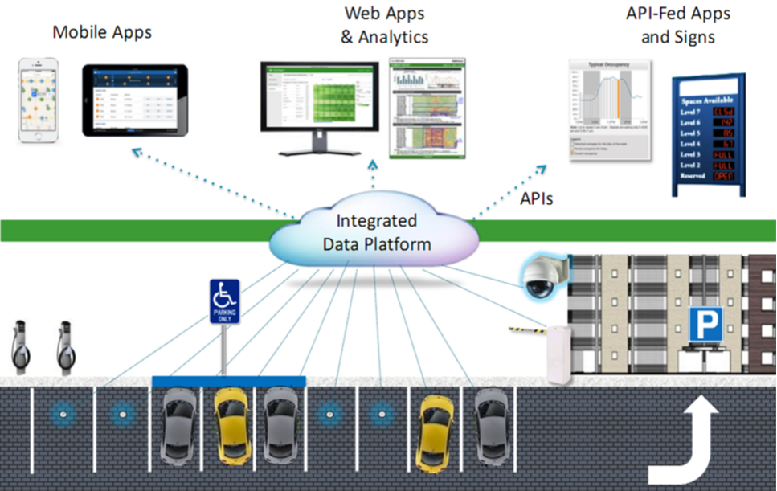
SYSTEM ARCHITECTURE
The system is divided into main components:
User Interface (Frontend) -Used for booking and payments
Application Server (Backend) – Handles user requests and process booking and payments
Database –stores user details and stores booking and parking data
IoT Devices (Sensors) – detect parking slot availability

Slide 11
USECASE DIAGRAM

Slide 12
CLASS DIAGRAM

Slide 13
SEQUENCE DIAGRAM

Slide 14
DisAdvantages of Existing System
Time-consuming process to find parking spaces
No real-time information about slot availability
Drivers must search manually for parking
Leads to high fuel consumption
Causes traffic congestion in busy areas
No option for online booking or reservation
Lack of automation and smart technology
Higher chances of human errors
Limited user convenience and accessibility
No proper data management or analysis

Slide 15
Advantages of Existing system
Convenience Users can book parking spots remotely, saving time and effort.
Time-Saving Reduces the need to search for parking, minimizing delays and frustration.
Traffic Reduction Decreases congestion caused by vehicles circling for parking spaces.
Real-Time Updates Provides accurate, up-to-date information on parking availability.
Secure Payments Supports integrated payment gateways for seamless transactions.
Efficient Management Enables better utilization of parking spaces through admin controls.

Slide 16
NOVELTY OF THE PROJECT
Provides real-time parking availability using smart technologies
Enables advance booking of parking slots from anywhere
Integrates IoT sensors for accurate slot detection
Uses GPS navigation to guide users to parking location
Supports online payment system for easy transactions

Slide 17
SOURCE CODE
# Book Slot @app.route('/book/<int:slot_id>') def book(slot_id): if parking_slots[slot_id] == 0: parking_slots[slot_id] = 1 return redirect(url_for('home')) # Release Slot @app.route('/release/<int:slot_id>') def release(slot_id): parking_slots[slot_id] = 0 return redirect(url_for('home')) if __name__ == '__main__': app.run(debug=True)
from flask import Flask, render_template, request, redirect, url_for app = Flask(__name__) # Sample parking slots (0 = free, 1 = booked) parking_slots = [0, 0, 0, 0, 0] # Home Page @app.route('/') def home(): return render_template('index.html', slots=parking_slots)

Slide 18
{% for i in range(slots|length) %} <tr> <td>{{ i }}</td> <td> {% if slots[i] == 0 %} Free {% else %} Booked {% endif %} </td> <td> {% if slots[i] == 0 %} <a href="/book/{{ i }}">Book</a> {% else %} <a href="/release/{{ i }}">Release</a> {% endif %} </td> </tr> {% endfor %} </table> </body> </html>
HTML FILE
<!DOCTYPE html> <html> <head> <title>Parking System</title> </head> <body> <h2>Online Parking Reservation</h2> <table border="1"> <tr> <th>Slot</th> <th>Status</th> <th>Action</th> </tr>

Slide 19
RESULTS
The system was successfully developed and tested
Users can:
Register and login
View available parking slots
Book and release slots
Real-time slot updates are working properly
Payment process is completed successfully
Outcome:
Reduced time to find parking
Improved user experience
Efficient parking management
System meets all project requirements

Slide 20
CONCLUSION
The system provides a smart solution for parking problems
Helps users find and book parking easily
Reduces time, fuel usage, and stress
Minimizes traffic congestion and pollution
Improves efficiency of parking management
Easy to use and user-friendly system
Supports digital and smart city development

Slide 21
FUTURE ENHANCEMENT
Add AI/ML to predict parking availability
Use advanced IoT sensors for better accuracy
Implement face recognition or biometric login
Add voice assistant support for easy access
Integrate with Google Maps for better navigation
Support multiple cities and large-scale deployment
Enhance security and data protection features

Slide 22
References
Smith, J., & Kumar, A. (2020) Smart Parking Systems: Technologies and Applications
International Journal of Intelligent Transportation Systems
Chen, L., & Zhang, H. (2019) IoT-Based Real-Time Parking Management System
IEEE Internet of Things Journal
Patel, R., & Joshi, M. (2021) Online Vehicle Parking Reservation System using Cloud Computing
Journal of Computer Networks and Communications
Gupta, S., & Singh, R. (2018) Secure Payment Integration in Online Reservation Systems
International Conference on Cybersecurity
Rao, P., & Thomas, K. (2017) Mobile Application Development for Smart Parking
International Conference on Mobile Computing

Slide 23
THANK YOU

